Slide 1
Fundamentals of UI/UX
--by Ms. Rushita Verlekar
BCA

Slide 2
User Interface
User interface (UI) is anything a user may interact with to use a digital product or service. This includes everything from screens and touchscreens, keyboards, sounds, and even lights.

Slide 3
A brief history of the user interface
Back in the 1970’s, if you wanted to use a computer, you had to use the command line interface. For a computer to work, users needed to communicate via programming language, requiring seemingly infinite lines of code to complete a simple task.
By the 1980’s the first graphical user interface (GUI) was developed by computer scientists at Xerox PARC. With this innovation, users could now interact with their personal computers by visually submitting commands through icons, buttons, menus, and checkboxes. This shift in technology meant that anyone could use a computer, no coding required, and the personal computer revolution began.
By 1984 Apple Computer released the Macintosh personal computer which included a point and click mouse. The Macintosh was the first commercially successful home computer to use this type of interface. It became a standard and the proliferation of Microsoft computers during the early 1990s.
If users couldn’t interact with their computers, they wouldn’t sell. As a result, the UI designer was born.

Slide 4
User interface (UI) design
User interface (UI) design is the process designers use to build interfaces in software or computerized devices, focusing on looks or style.
Designers aim to create interfaces which users find easy to use and pleasurable.
The user interface is the graphical layout of an application.
It consists of the buttons users click on, the text they read, the images, sliders, text entry fields, and all the rest of the items the user interacts with.
This includes screen layout, transitions, interface animations and every single micro-interaction.
Any sort of visual element, interaction, or animation must all be designed.

Slide 5
User interface (UI)
UI designers decide what the application is going to look like. They have to choose color schemes and button shapes — the width of lines and the fonts used for text. UI designers create the look and feel of an application’s user interface.
UI designers are graphic designers. They’re concerned with aesthetics. It’s up to them to make sure the application’s interface is attractive, visually-stimulating and themed appropriately to match the purpose and/or personality of the app.
And they need to make sure every single visual element feels united, both aesthetically, and in purpose.

Slide 6
What is UX Design?
“UX” stands for “user experience.”
A user’s experience of the app is determined by how they interact with it.
Is the experience smooth and spontaneous or old-fashioned and confusing? Does navigating the app feel logical or does it feel illogical?
Does interacting with the app give people the sense that they’re efficiently accomplishing the tasks they set out to achieve or does it feel like a struggle?
User experience is determined by how easy or difficult it is to interact with the user interface elements that the UI designers have created.

Slide 7
What is a wireframe?
It is an Architectural blueprint, a wireframe is a two-dimensional skeletal outline of a webpage or app.
Wireframes provide a clear overview of the page structure, layout, information architecture, user flow, functionality, and intended behaviors.
As a wireframe usually represents the initial product concept, styling, color, and graphics are kept to a minimum.
Wireframes can be drawn by hand or created digitally, depending on how much detail is required.
Wire framing is a practice most commonly used by UX designers. This process allows all stakeholders to agree on where the information will be placed before the developers build the interface out with code.

Slide 8
When does wireframing take place?
The wireframing process tends to take place during the exploratory phase of the product life cycle.
During this phase, the designers test the scope of the product, collaborating on ideas, and identifying business requirements.
A wireframe is usually the initial iteration of a webpage, used as a jumping-off point for the product’s design.

Slide 9
What is the purpose of wireframing?
Wireframes keep the concept user-focused.
  Wireframes facilitate feedback from the users, instigate conversations with the stakeholders, and generate ideas between the designers.
Wireframes clarify and define website features
  Wireframing specific features will clearly communicate to your clients how they’ll function and what purpose they’ll serve.
  It may even prompt you to decide to remove a few if you feel they’re not quite working with the rest of the page’s elements.
Wireframes are quick and cheap to create

Slide 10
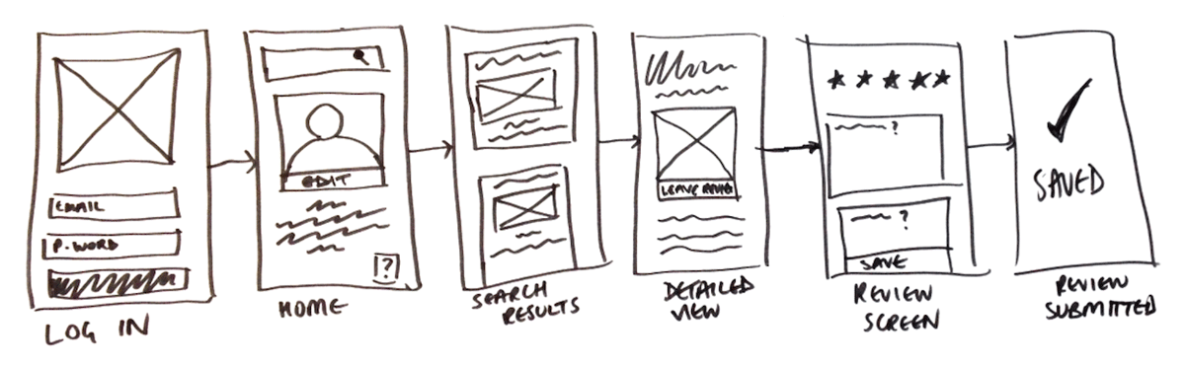
What are the different types of wireframes?
Low-fidelity wireframes

Slide 11
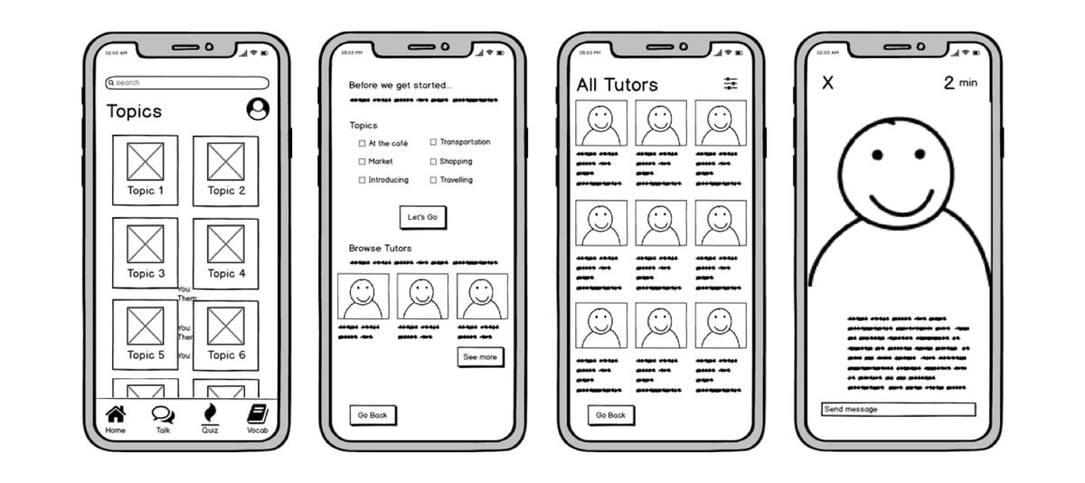
What are the different types of wireframes?
2. Mid-fidelity wireframes

Slide 12
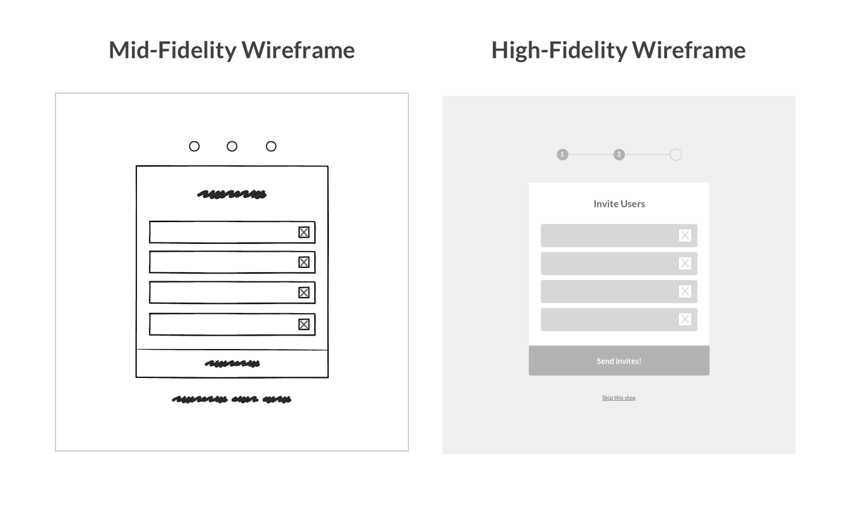
What are the different types of wireframes?
3. High-fidelity wireframes

Slide 13
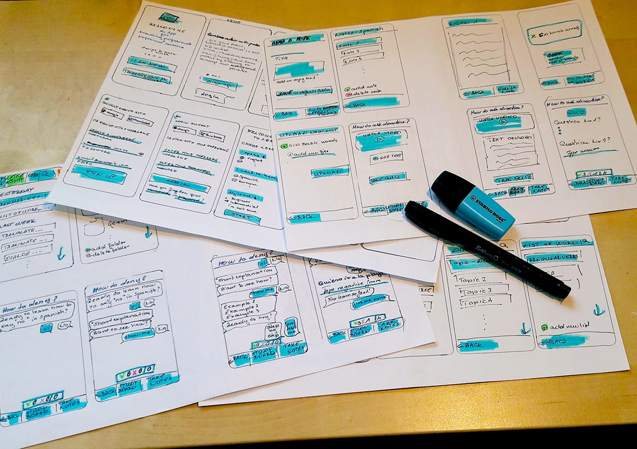

Slide 14
Free Tool for wireframing
https://www.figma.com/

